Slide 1
MICRO CREDIT DEFAULTER PROJECT
Submitted by
Khanin Deka

Slide 2
PROBLEM STATEMENT Build a machine learning model in order to predict whether a consumer will repay the loaned amount within the stipulated time or not.

Slide 3
The Dataset 1) The dataset contains 209593 rows and 37 columns. 2) Out of the 37 columns, 21 are of float data-type, 13 of int and 3 of object data-type. 3) There are no missing values in the dataset.

Slide 4
DATA PREPROCESSING 1. 'Unnamed: 0' column is deleted as it is used for numbering the entries in the dataset. 2. 'msisdn' column is deleted as it contains the mobile numbers of the customers which is not an useful data for us. 3. 'pcircle' column is deleted as it contains only one unique value for the entire column. 4. 31 duplicate entries found which were removed. 5. On 'pdate' column pandas to_datetime method is applied and the day, month and year data is extracted into separate columns. The ‘pdate’ column is then removed. 6. 'year' column is deleted as all the entries correspond to a single year i.e. 2016

Slide 5
7. The ‘pearson’ correlation of the features with the label is calculated. All the features with correlation less than 0.05 with the label are dropped as the correlation is considered statistically insignificant. 8. If we carefully see the features then we will find that a lot of them have data for last 30 and 90 days of same feature like ‘daily_decr30’ and ‘daily_decr90’. Both represent the averaged daily amount spent from main account, but over the duration of 30 days and 90 days. To check for muticollinearity among them correlation heat-map and variance inflation factor (VIF) is used. All the feature-pairs with correlation above 0.85 are checked for VIF scores. VIF score of above 5 is considered to be a multicollinearity issue. Hence out of the two features which are multicollinear, one is dropped. Whichever feature among the two have lower correlation with label is dropped. 9. The skewness of the continuous data features is checked. All of them have very highly skewed data.

Slide 6
10. Cube-root and power transformations are applied to bring down the skewness. 11. Features on which power transformation is applied are: 'last_rech_amt_ma','cnt_ma_rech30', 'amnt_loans90' 'medianamnt_ma_rech30' and 'fr_ma_rech90' 12. Features on which cube-root transformation is applied are: 'daily_decr30','rental90' and 'sumamnt_ma_rech90'. 13. The features are then scaled using ‘StandardScaler’ of scikit-learn. 14. Since the target variable is highly imbalanced, hence SMOTE upsampling is done on training dataset.

Slide 7
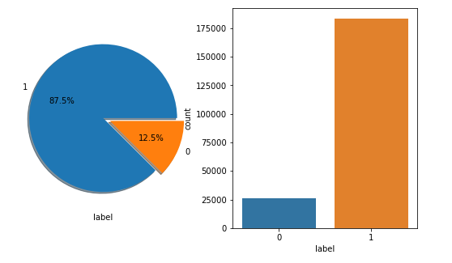
VISUALIZATION & OBSERVATIONS Lets see plots showing the relation between features and label Pie-plot and count-plot of label:

Slide 8
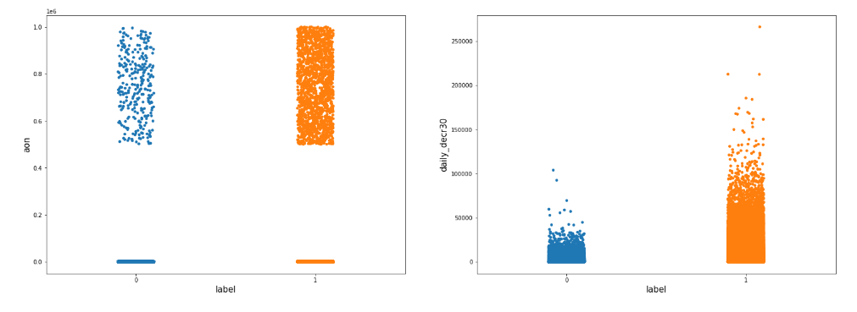
Strip-plots of ‘aon’ and ‘daily_decr30’ with the label:

Slide 9
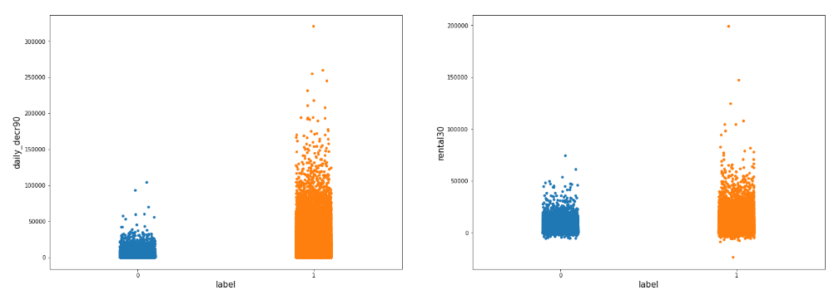
Strip-plots of ‘daily_decr90’ and ‘rental30’ with the label:

Slide 10
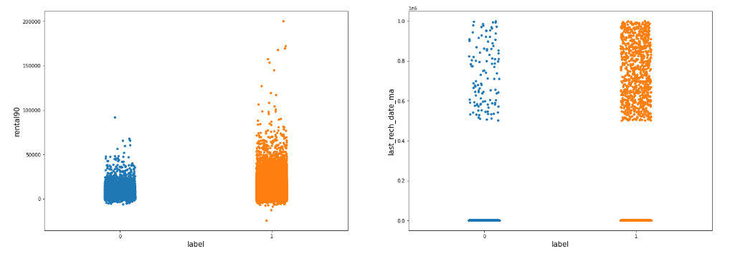
Strip-plots of ‘rental90’ and ‘last_rech_date_ma’ with the label:

Slide 11
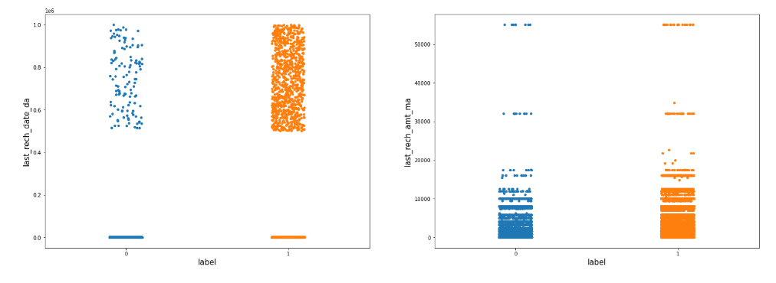
Strip-plots of ‘last_rech_date_da’ and ‘last_rech_amt_ma’ with the label :

Slide 12
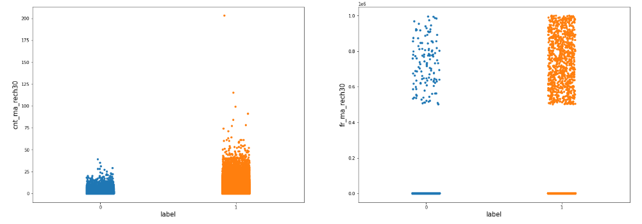
Strip-plots of ‘cnt_ma_rech30’ and ‘fr_ma_rech30’ with the label:

Slide 13
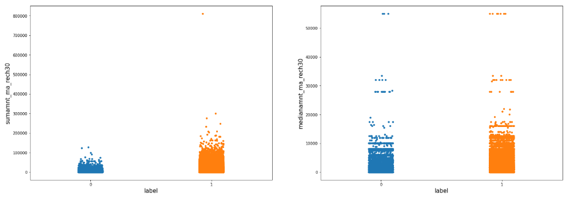
Strip-plots of ‘‘sumamnt_ma_rech30’ and ‘medianamnt_ma_rech30’ with the label:

Slide 14
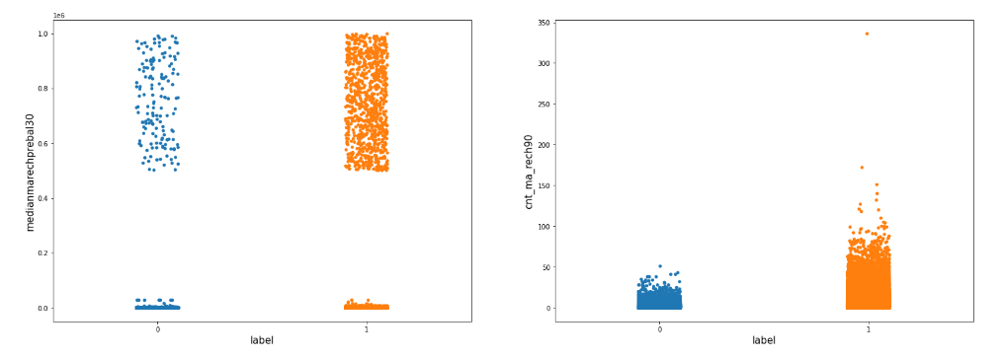
Strip-plots of ‘medianmarechprebal30’ and ‘cnt_ma_rech90’ with the label:

Slide 15
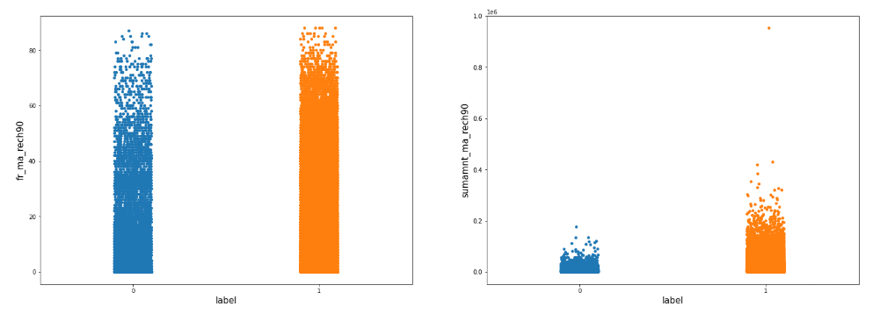
Strip-plots of ‘fr_ma_rech90’ and ‘sumamnt_ma_rech90’ with the label:

Slide 16
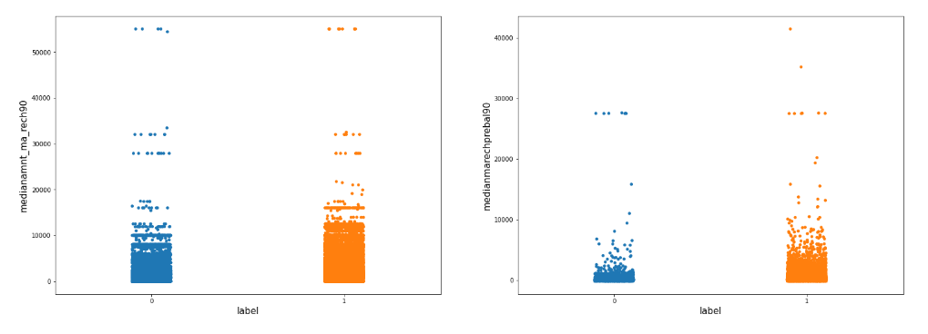
Strip-plots of ‘medianamnt_ma_rech90’ and ‘medianmarechprebal90’ with the label:

Slide 17
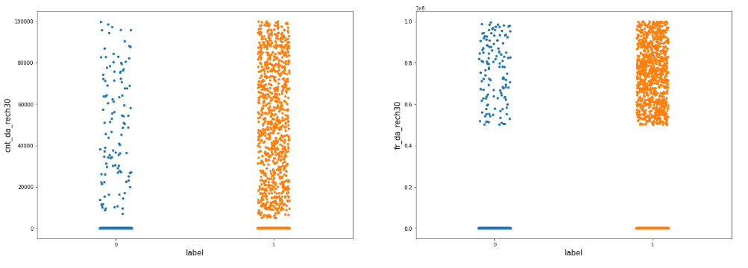
Strip-plots of ‘cnt_da_rech30’ and ‘fr_da_rech30’ with the label:

Slide 18
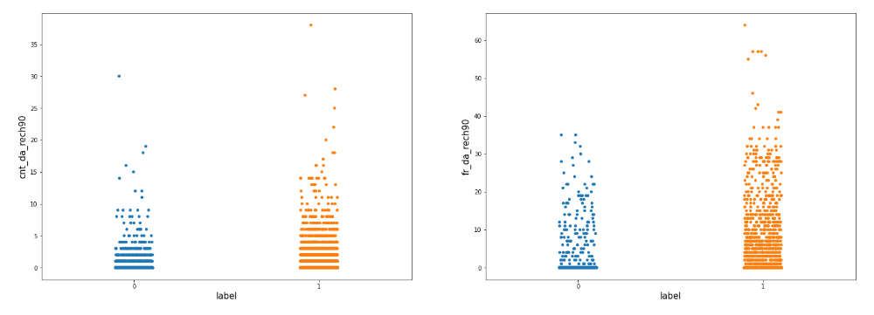
Strip-plots of ‘cnt_da_rech90’ and ‘fr_da_rech90’ with the label:

Slide 19
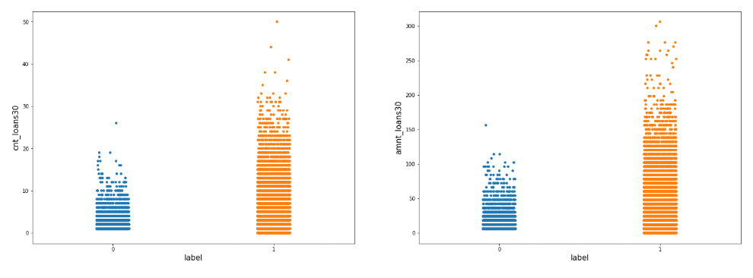
Strip-plots of ‘cnt_loans30’ and ‘amnt_loans30’ with the label:

Slide 20
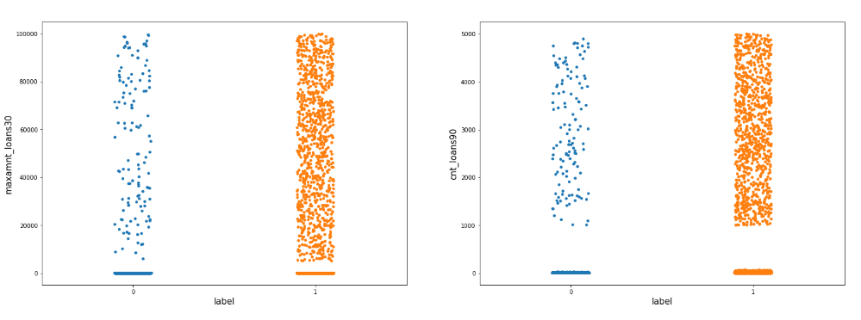
Strip-plots of ‘maxamnt_loans30’ and ‘cnt_loans90’ with the label:

Slide 21
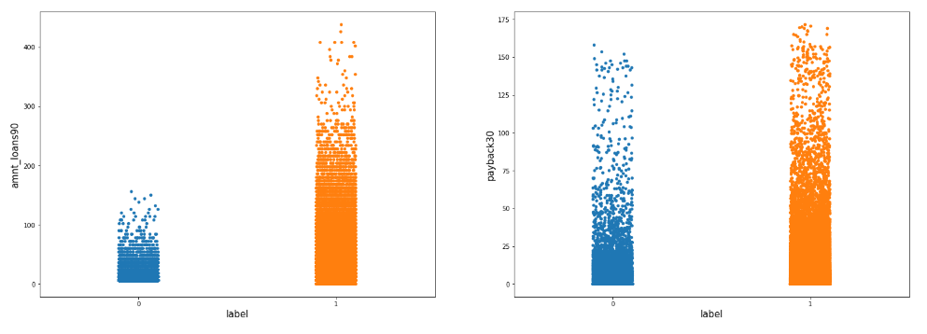
Strip-plots of ‘amnt_loans90’ and ‘payback30’ with the label:

Slide 22
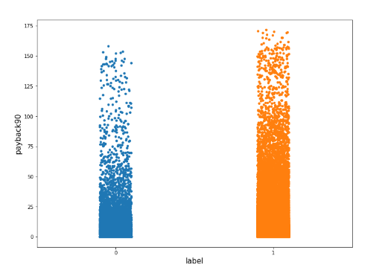
Strip-plot of ‘payback90’ with the label:

Slide 23
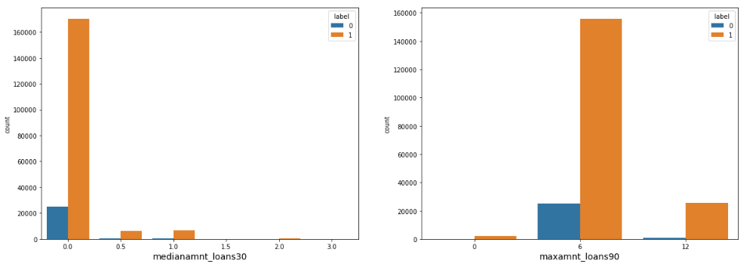
Count-plots of ‘medianamnt_loans30’ and ‘maxamnt_loans90’ with color coding of the label:

Slide 24
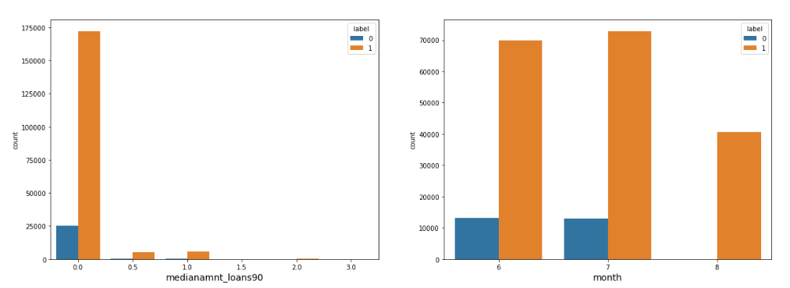
Count-plots of ‘medianamnt_loans90’ and ‘month’ with color coding of the label:

Slide 25
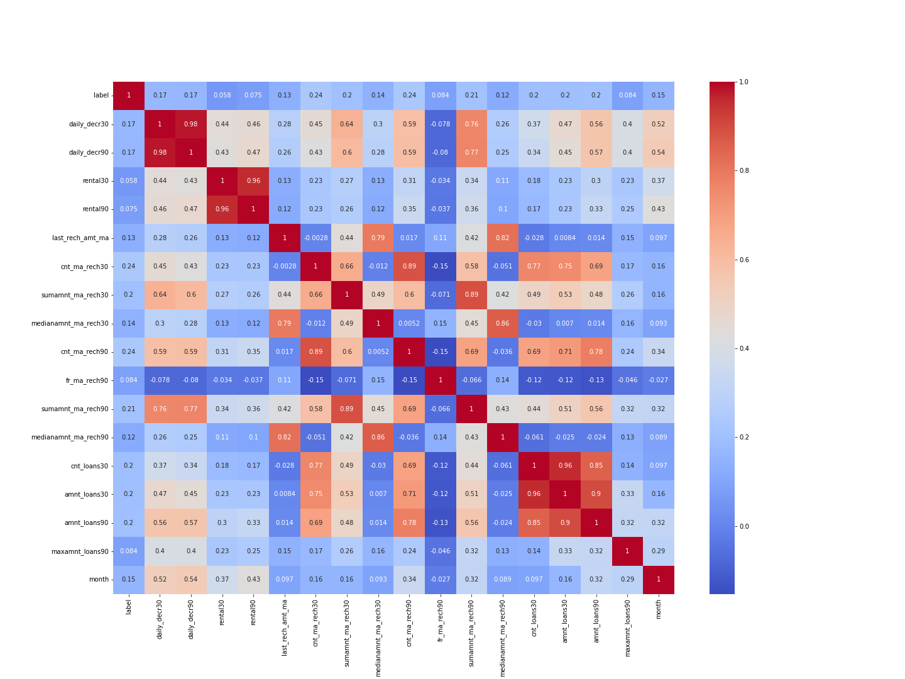
Correlation Heat-map:

Slide 26
Performance Evaluation To evaluate the classification models the following metrics are used: 1. Accuracy: It is the number of correct predictions divided by the total number of predictions. 2. Precision: It is proportion of positive predictions that are actually correct. In our case, precision with respect to defaulters is the proportion of positive-defaulter predictions that are actually defaulters. 3. Recall: It is the proportion of actual positives that predicted correctly by the model. In our case, recall with respect to defaulters is the proportion of actual defaulters that are predicted correctly by the model. 4. ROC-AUC: ROC is a probability curve and AUC represents the degree or measure of separability. It tells how much the model is capable of distinguishing between classes. Higher the AUC, the better the model is at predicting 0 classes as 0 and 1 classes as 1.

Slide 27
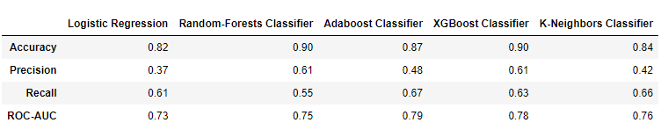
The performance is evaluated for five different algorithms. They are: a) Logistic Regression b) Random Forests Classification c) Adaboost Classification d) XGBoost Classification e) KNN Classification. Train-test split 1 results:

Slide 28
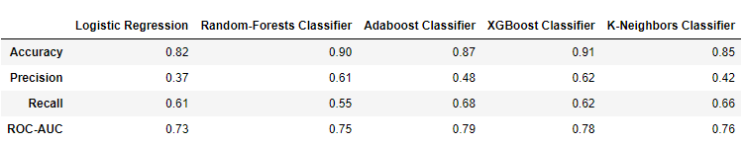
Train-test split 2 results: It can be seen that XGBoost Classifier is giving the best overall performance if we consider all metrics. Random-Forests have a good accuracy but the recall score is not good enough. Adaboost has better recall than XGBoost but the precision is not good enough. Let’s move ahead with XGBoost Classifier and try to tune it further.

Slide 29
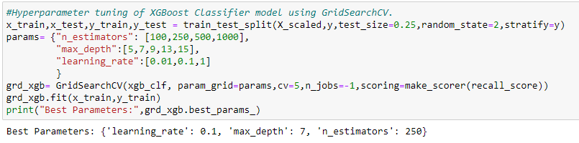
Hyper-parameter tuning: 3 hyper-parameters of XGBoost are tuned: ‘n_estimators’, ‘max_depth’ and ‘learning_rate’. The best parameters are found to be 0.1, 7 and 250 respectively.

Slide 30
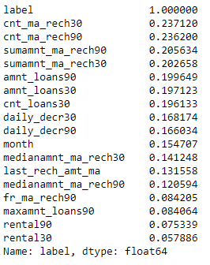
CONCLUSION Key Findings: 1. The top 17 features affecting whether a customer is likely to be a defaulter are shown below in a list along with the Pearson standard correlation coefficient. 2. XGBoost Classification Algorithm is giving the best results for prediction of defaulters. It gives accuracy of around 90%. Limitations of this work: 1. The hyper-parameters of our final model can be further tuned. 2. In this project we worked on only 5 algorithms. There are numerous other classification algorithms with which we can try to make a better model.

